Slide 1


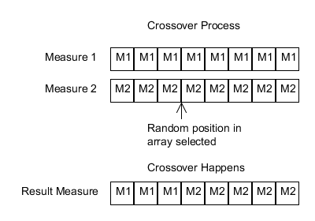
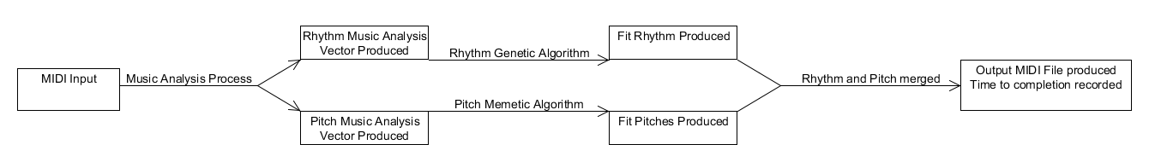
Digital Music Composition using Simultaneous Genetic Algorithms
Stephen Bussey
Advisor: Dr. Alice Armstrong
Problem Statement
Summary Explanation
Experiment Design
Musicians can become lacking in inspiration
Current genetic algorithm techniques are heavily dependent on an operator and are inherently subjective
Current genetic algorithm techniques generate rhythms and tones with a single algorithm, which may not be optimal
Music is represented in a structure that is very representative of the format of music. That is, it is very similar to how humans read and digest sheet music.
A number of different transformations are applied. These transformations deal with the structure of music and not technical components.
For each input music:
Genetic algorithms for rhythm and tone execute (time is collected)
The results of the algorithms are combined into an output MIDI file (time is collected)
This was run 30 times per input
This music is given a score based on a number of criteria derived from other research papers.
Once a generated piece is close enough to the input, then that piece is finalized.
Two different pieces can be easily compared to each other based on their score’s Euclidean distance.
Rhythm and tones are processed separately and the pieces are combined at the end. This makes it easier to process and reduces the search space greatly.
Conclusions
Primary Research Objective
The algorithms developed performed well and created music that is aesthetically pleasing and did so very quickly and reliably. This makes them a promising solution to the problem of algorithmic music composition.
To compose music using genetic and memetic algorithms by concurrently and separately processing the rhythmic and tonal components
Results
Non-Divide and Conquer
Of the 900 runs, 6 failed (.67%)
The average time with failures present was 27.04s ± 43.7s
The average time with failures removed was 24.7s ± 32.7s
Solution Description
Further Work
Input analyzed using Music Analysis Process: rhythmic and pitch music analysis vectors (MAV) produced
Rhythmic genetic algorithm executes using rhythmic MAV: Measure[] array of beats produced
Pitch memetic algorithm executes using pitch MAV: Measure array of pitches produced
Pitch and rhythm merged into MIDI output: time recorded
The rating algorithm was not nearly as optimized as it could be. An experienced music theorist could improve this feature to greatly increase the conversion rate.
Optimizing Divide & Conquer algorithm could greatly increase generation time and produce more accurate pieces
Divide and Conquer
Of the 900 runs, 138 failed (15.33 %)
The average time with failures present was 68.1s ± 132.6
The average time with failures removed was 16.4s ± 22.7s
While audio results are difficult to quantitate, it is easier to qualitatively judge them. The output performed best on simpler initial melodies, and one can tell that there are similarities between the input and what was produced. Complex patterns did not sound as good and sometimes did not finish.
Acknowledgements
Shippensburg University Computer Science Department
Shippensburg University Honors Program

